Slide 1
Robotics ECA

Slide 2
Goals of the eca
What & why robotics
Problem solving
The ability to automate things
enhance daily life
To have fun and learn
Exploring inner workings of microcontrollers and their link to robotics
Exploring ways we can use it to automate tasks and assist us in daily life
Using different sensors and how to code with them
Creating our own automated system using the Arduino platform

Slide 3
What is a computer
Computers follow instructions in the form of code
Computers have Inputs and outputs
Computers receive inputs and using the instructions, generate an output
Eg. Key press => keyboard handler code => code of word.exe => display output letter A on screen

Slide 4
Computer vs Microcontrollers
Flash storage=> stores additional assets that does not have to be quickely
Ram (random access memory) => stores the code and additional assets that is currently being operated on
CPU - central processing unit => executes operation of code
additional hardware accelerator units eg. gpu npu etc.
Programmed by another computer
runs code line by line
inputs and outputs in the form of pins
Electrical connection with other components

Slide 5

Arduino
Open source platform for embedded development
number of beginner guides on code and sample tutorials
easy to understand libraries, simple to use software
works on most operating systems, work out of the box without any additional configurations
comes in different form factors for different use cases

Slide 6
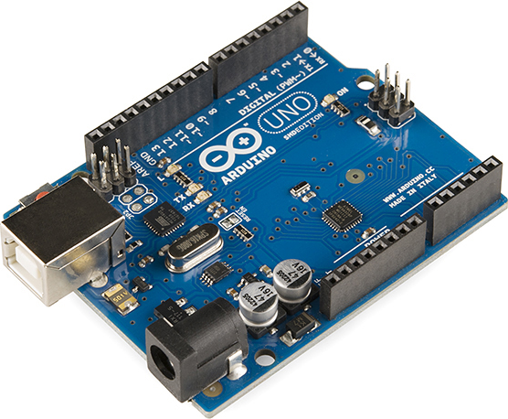
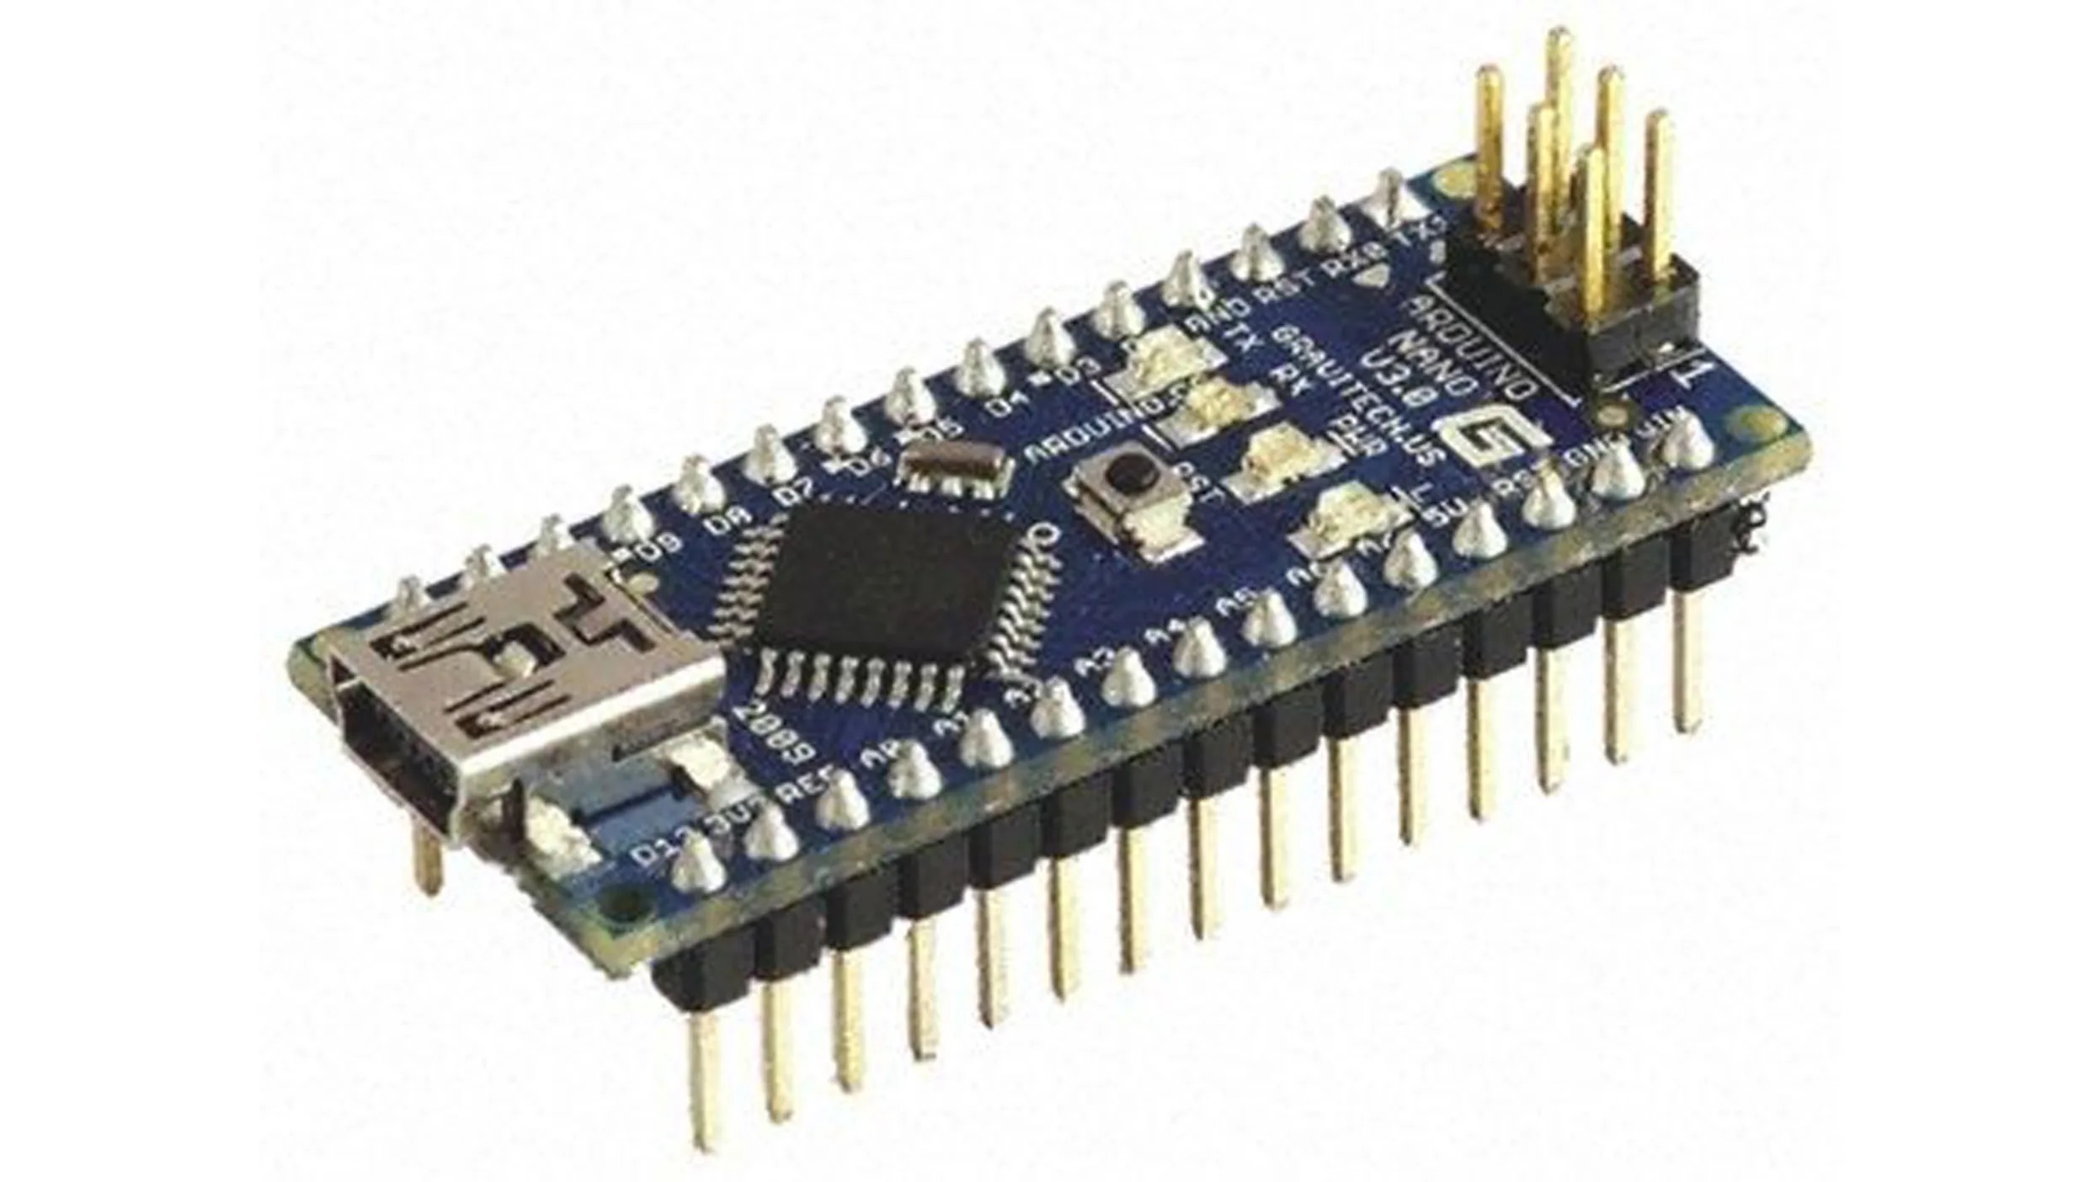
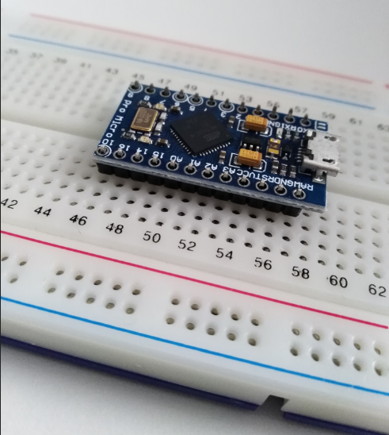
Arduino boards
Arduino uno & Arduino nano, works exactly the same usage wise but in different form factors
Nano is smaller and can be attatched onto a bread board, for more expansive connection onto other boards as you can build circuits on the bread board itself
Uno has direct header pins allowing you to plug wires in directly.

Slide 7
Microcontroller Basics
Legs of the microcontroller are called pins
Normally the functions of the pins range from input and output (we call these pins GPIO general purpose input output) and also power pins, the power pins allow you to boot the board without touching usb cable, and powering additional sensors from this one.

Slide 8
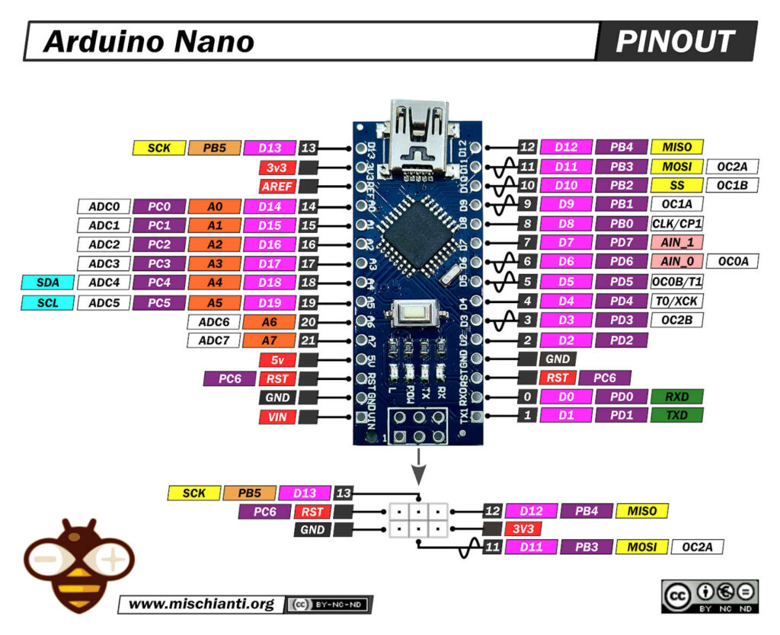
GPIO General purpose input output
GPIO pins are labeled with the letter D as labeled. pins with analog functions are labeled starting with A, and the two power pins 3v3 or 5v can be used to get a temporary source to power an additional sensor
These gpio pins can be configured on the fly, to be an input or an output within the code. Inputs sense

Slide 9
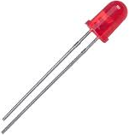
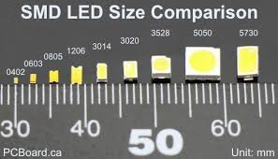

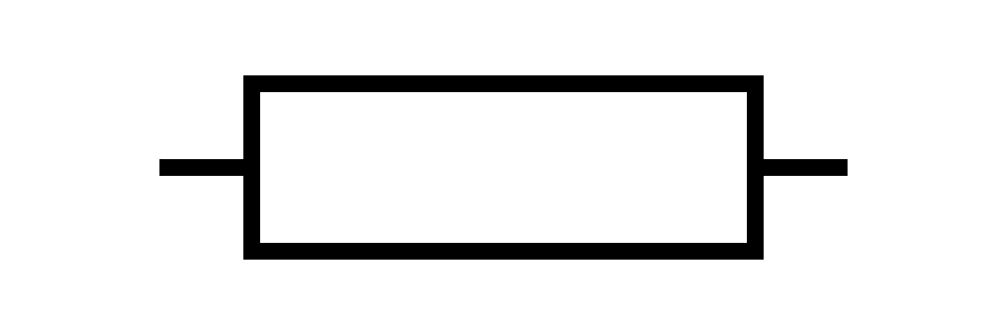
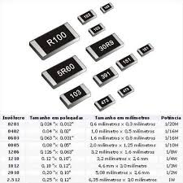
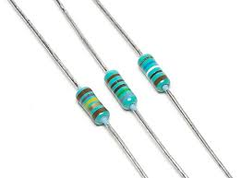
Circuitry
LED (light emitting diode): lights up when current flows through direction of the arrow
Resistor: resists the flow of current to flow

Slide 10
Circuitry

Slide 11
Circuitry

Slide 12
Outputs
pinMode(5, OUTPUT); configures Pin 5 as Output
digitalWrite(5, HIGH); Set Pin 5 to high state (3.3v)
delay(1000); wait for a 1000 milliseconds (1 second)
void setup() {
// initialize digital pin LED_BUILTIN as an output.
pinMode(5, OUTPUT);
}
// the loop function runs over and over again forever
void loop() {
digitalWrite(5, HIGH); // turn the LED on (HIGH is the voltage level)
delay(1000); // wait for a second
digitalWrite(5, LOW); // turn the LED off by making the voltage LOW
delay(1000); // wait for a second
}

Slide 13
Inputs - Code
#define BUTTON_PIN 4
void setup()
{
Serial.begin(9600);
pinMode(BUTTON_PIN, INPUT_PULLUP);
}
void loop()
{
Serial.println(digitalRead(BUTTON_PIN));
delay(100);
}
pinMode(BUTTON_PIN, INPUT); configures the pin as input
digitalRead(BUTTON_PIN) function that outputs either one or a zero based on if the current pin is physically high or low
Serial.println() Prints to serial monitor

Slide 14
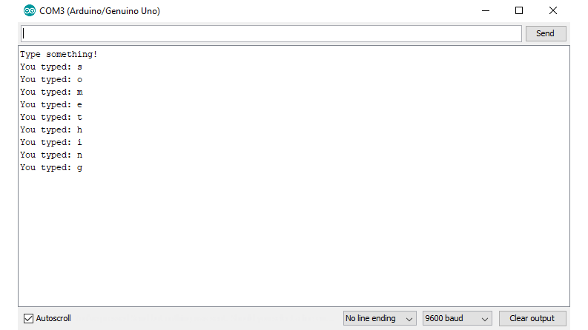
Serial Monitor
#define BUTTON_PIN 4
void setup()
{
Serial.begin(9600);
pinMode(BUTTON_PIN, INPUT_PULLUP);
}
void loop()
{
Serial.println(digitalRead(BUTTON_PIN));
delay(100);
}
An additional output used for testing purposes
Serial.begin(9600); Enable and initialize serial monitor
Serial.println(); Prints text to the serial monitor for reading
You can print any string you want, or print the value of a variable

